Slide 1

YSPM's Yashoda Technical Campus
Sorting Visualization
Represented By:
Aishwarya Kumbhar (2067571242015)
Rutuja Mane(2067571242013)
Aarti Palande (2067571242020)
Muskan Shaikh (2067571242007)

Slide 2
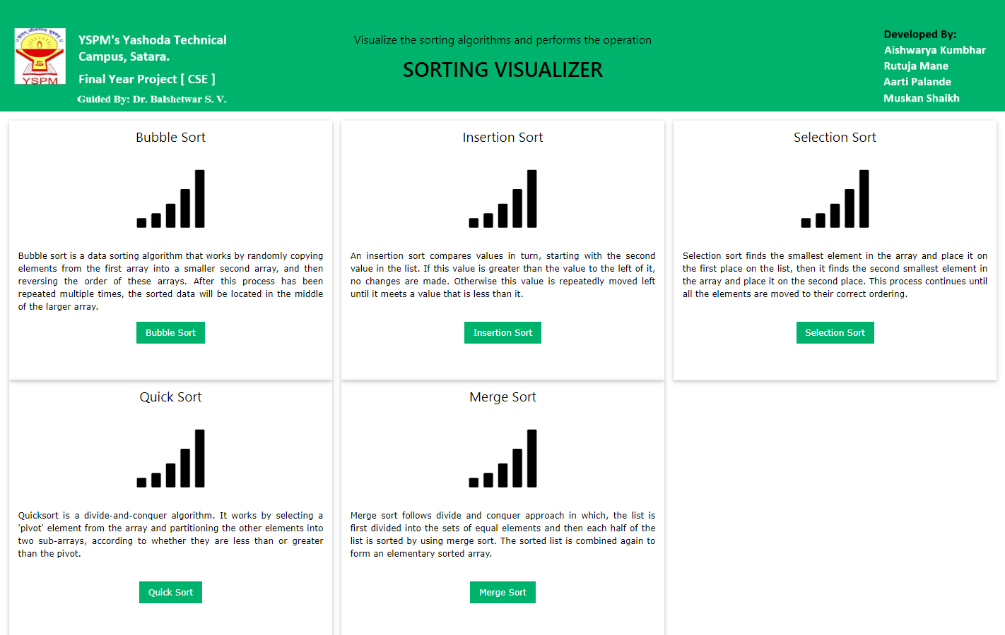
Introduction
We have learnt sorting algorithms like bubble sort, selection sort, insertion sort, quick sort. But often we fail to understand the core idea of a particular algorithm maybe because we are unable to visualize how they work. So the most important thing to understand about these algorithms is visualization.

Slide 3



Tool
Visual Studio Code
Google Chrome
Languages
HTML
CSS
JavaScript

Slide 4
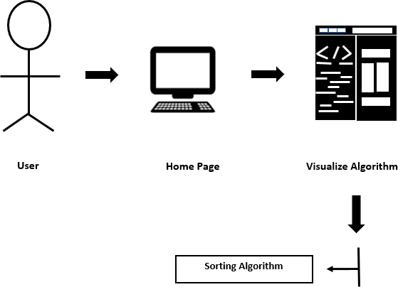
System Architecture

Slide 5
Scope
The main goal of this project was to create a teaching support software with visualization of the most known sorting algorithms and their variations. The application supports a graphic visualization of selected algorithms on randomly generated or manually created array, step-by-step execution possibility, pseudo code and current state of variables.
We have learnt sorting algorithms like bubble sort, selection sort, insertion sort, quick sort. But often we fail to understand the core idea of a particular algorithm maybe because we are unable to visualize how they work. So the most important thing to understand about these algorithms is visualization.

Slide 6
Thank You

